Slide 1
Progressive Enhancement of Label Distributions for Partial Multilabel Learning
Ning Xu, Member, IEEE, Yun-Peng Liu, Yan Zhang, and Xin Geng, Senior Member IEEE
Presentation：Chen Ning
Supervisor：Shen-Huan Lyu
Date: 13/4/2024

Slide 2
Table of Contents
1
Introduction
2
Related Work
3
Proposed Method
4
Experiments
5
Conclusion

Slide 3
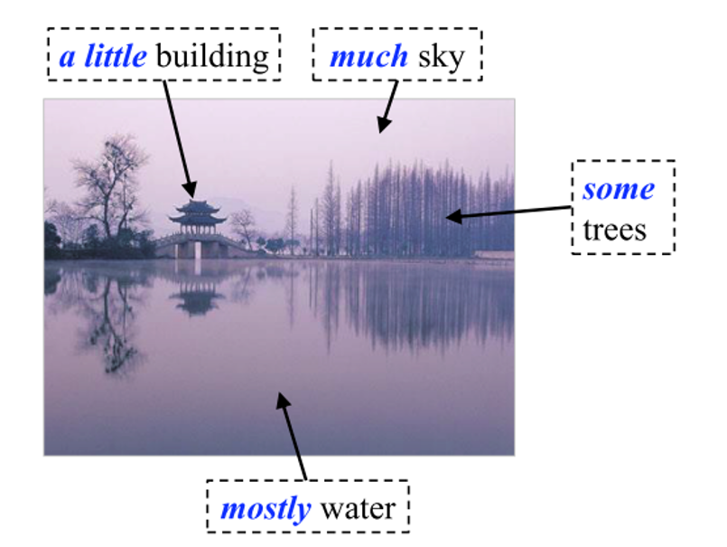
Label Distribution Learning
What’s the Label Distribution Learning
Notes:
学习出潜在的标签分布信息，发掘标签对于实例的正要程度，如图所示的 mostly、much

Slide 4
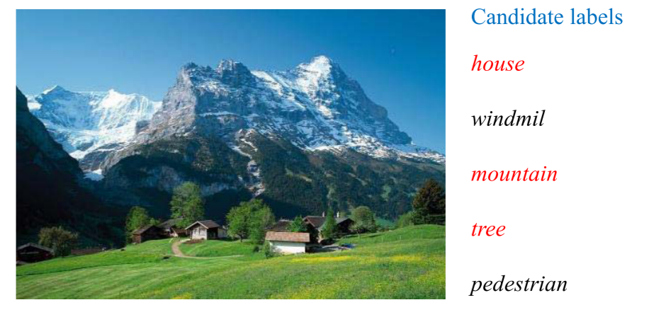
Partial Multi-Label Learning
Label is partially known or incomplete.
Notes:
部分已知强调标签的真实性
不完整强调标签集中包含错误标签

Slide 5
Partial Multi-Label Learning
A key assumption
The candidate label set must contains all valid label.
Target
Identifying the valid labels in candidate label set.
Notes:
候选标签必须包含所有的有效标签

Slide 6
Partial Multi-Label Learning
Current methods
Partial multi-label learning utilizes the confidence degree of each candidate label. But, this ignores the relevance of the non-candidate labels.
Partial multi-label learning by low-rank and sparse decomposition use low-rank to identify the noisy label.
Partial multi-label learning via credible label elicitation improves candiate label reliability via iterative label propagation.
Notes:
候选标签成为有效标签的置信度，但忽略了非候选标签之间的相关性，导致假正例增加

Slide 7
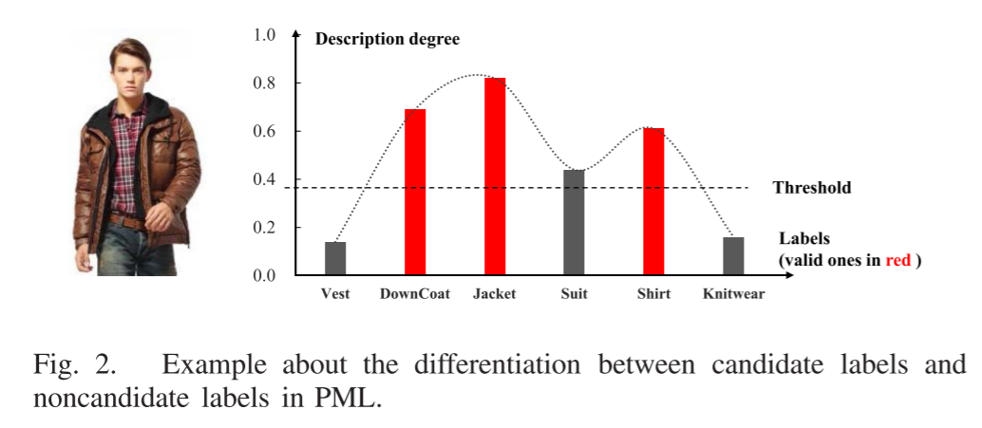
Partial Multi-Label Learning
Article’s method
Construct a real-valued vector for each label.
Notes:
使用标签分布来解决PML问题，标签分布的真值向量可以反映标签对于实例的重要程度
问题：对于相关和不相关之间的标签要有区分度，标签增强无法处理false-positive labels

Slide 8
Table of Contents
1
Introduction
2
Related Work
3
Proposed Method
4
Experiments
5
Conclusion

Slide 9
Related Work
Multi-label learning
First-order
Second-order
High-order
Partial multi-label learning
All candidate is valid
Identifying the ground-truth label
Notes:
多标签学习，可以直接从候选标签获取有效标签，且大致分为三类方法：一阶、二阶、高阶（狼、月亮、森林）。
部分多标签学习需要自行发掘有效标签

Slide 10
Related Work
Label Distribution Learning
maximum entropy model with Kullback–Leibler divergence as loss function
label enhancement
LE cannot deal with the false-positive labels in PML and usually don’t involve in the subsequent model induction.
Notes:
标签增强来恢复标签分布，但通常作为一个前置手段，因此忽略了为后续模型归纳生成更合适的标签分布

Slide 11
Table of Contents
1
Introduction
2
Related Work
3
Proposed Method
4
Experiments
5
Conclusion

Slide 12
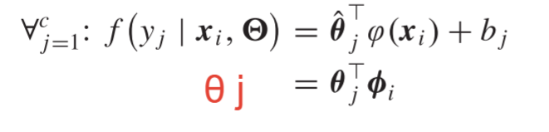
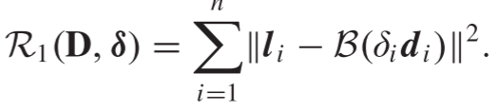

Proposed Method
The predictive model
The two kind of regularization
Notes:
L 是给出的一部分向量值，D 通过标签分布进一步补充

Slide 13
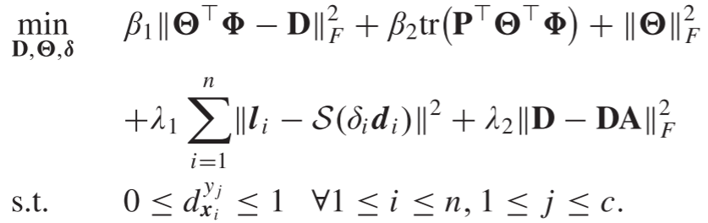
Proposed Method
The final optimization target
A proper label

Slide 14
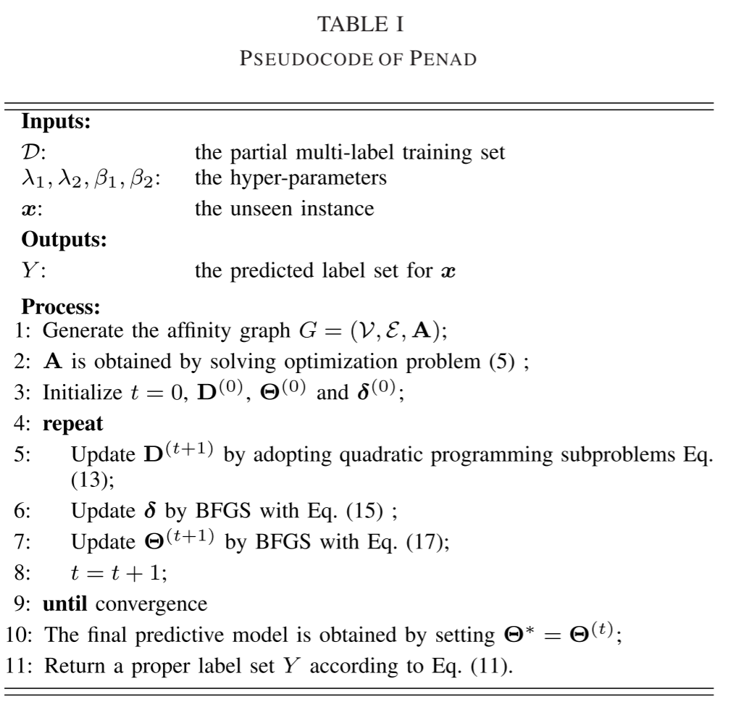
Proposed Method
The algorithm

Slide 15
Table of Contents
1
Introduction
2
Related Work
3
Proposed Method
4
Experiments
5
Conclusion

Slide 16
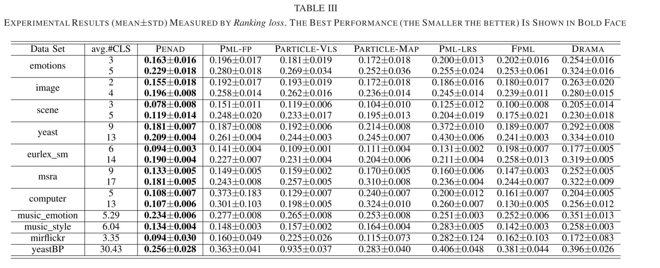
Experiments
Performance evaluation

Slide 17
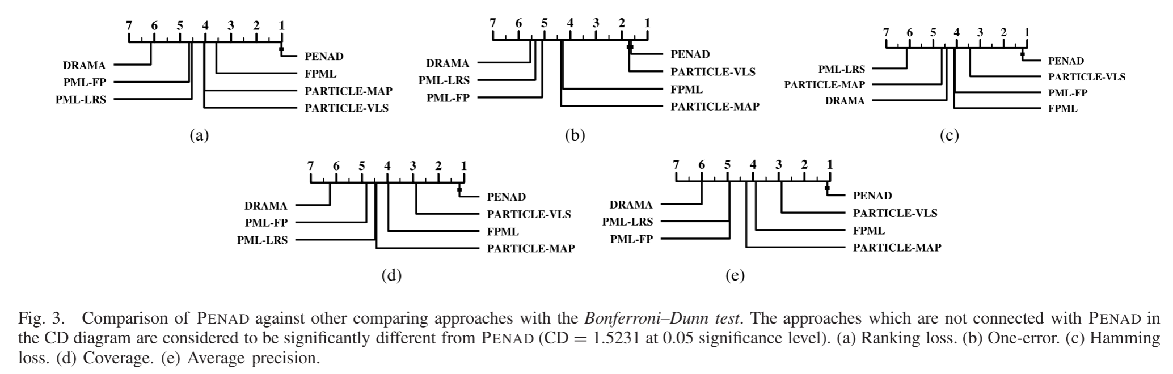
Experiments
The Friedman test

Slide 18
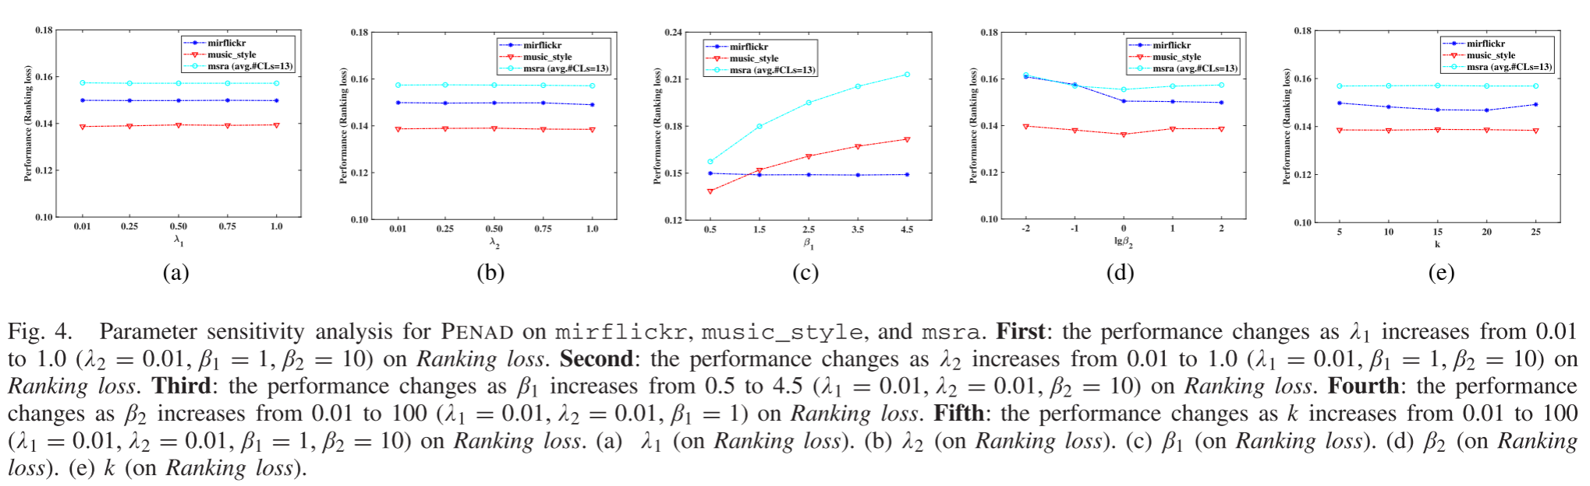
Experiments
Sensitivity Analysis

Slide 19
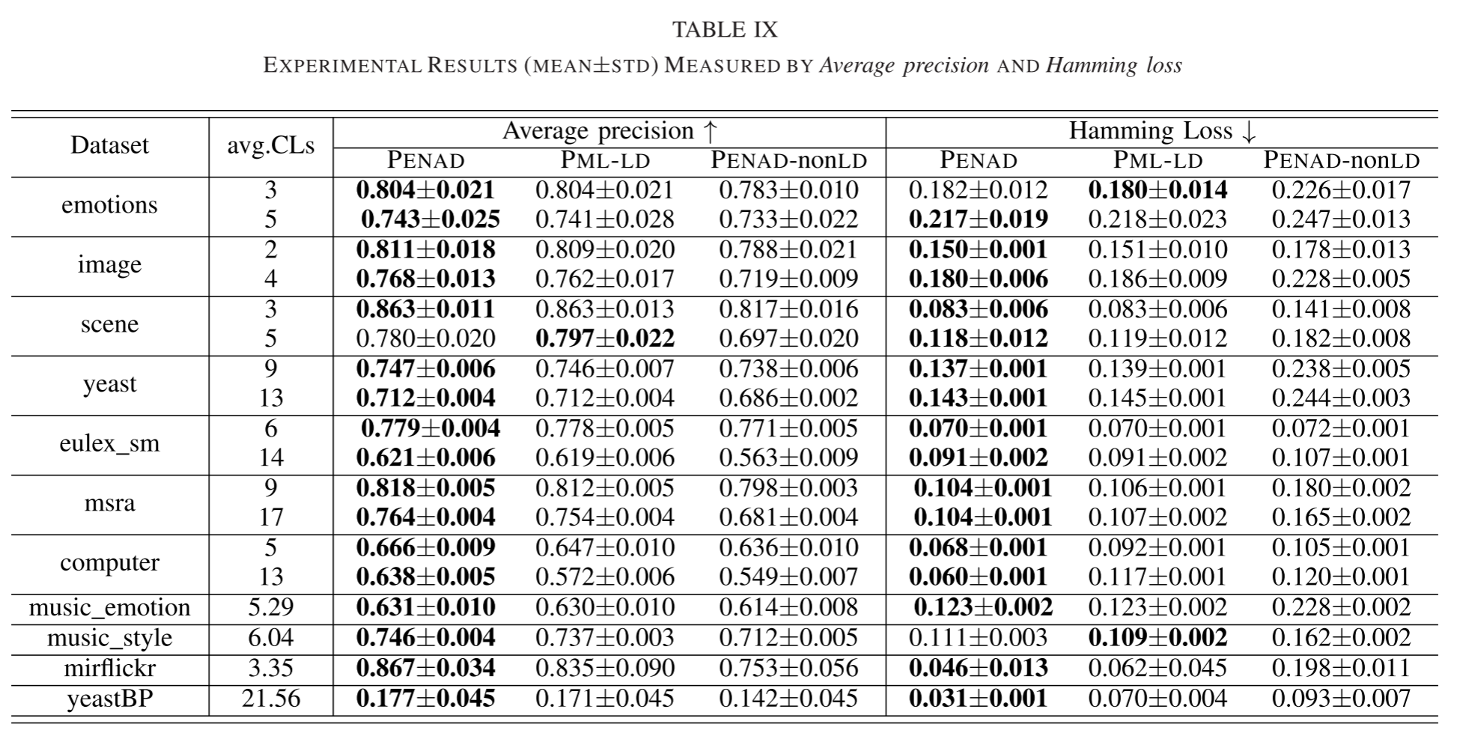
Experiments
Ablation Studies

Slide 20
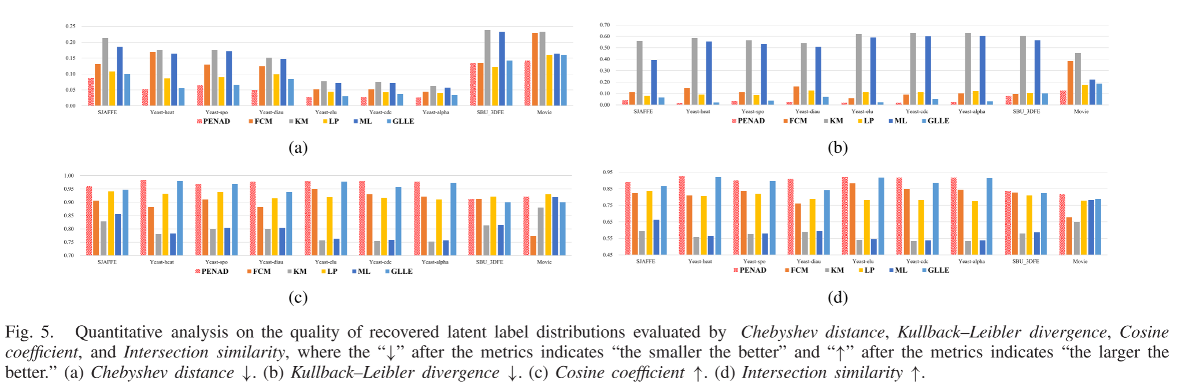
Experiments
Quality of Recovered Latent Label Distributions

Slide 21
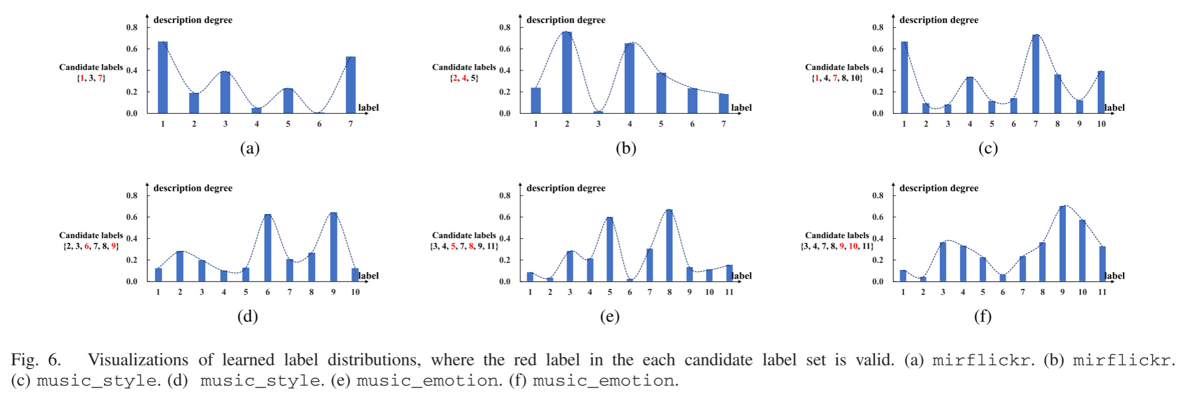
Experiments
The visualizations results

Slide 22
Conclusion
The Label Distribution for PML is possible
The question of LE that cannot deal with false-positive labels still needs to be addressed.

